Slide 1
Lecture No. 45
At the end of this Lecture , student will be able to:
Explain the physical vapour deposition method of synthesis of nano materials
Differentiate between CVD and PVD methods
Describe the applications of nanomaterials in various industries

Slide 2
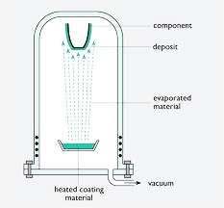
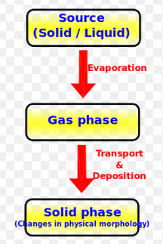
Physical vapour deposition (PVD)
PVD is used for high melting point & low vapor pressure materials
PVD is carried out at high temperature and vacuum of different ranges is used which depends on the mean free path required in the system
PVD is an alternative process to electroplating

Slide 3
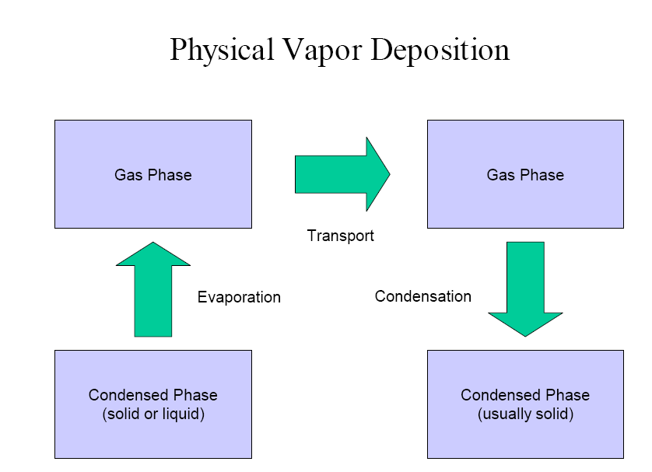
Working Concept
PVD processes are carried out under vacuum conditions: process involved four steps- 1.Evaporation 2.Transportation 3.Reaction 4.Deposition

Slide 4
Advantages of PVD
PVD coatings are sometimes harder and more corrosion resistant than coatings applied by the electroplating process
Most coatings have high temperature and good impact strength, excellent abrasion resistance and are so durable that protective topcoats are almost never necessary
Ability to utilize virtually any type of inorganic and some organic coating materials on an equally diverse group of substrates and surfaces using a wide variety of finishes
More environmentally friendly than traditional coating processes such as electroplating and painting
More than one technique can be used to deposit a given film

Slide 5
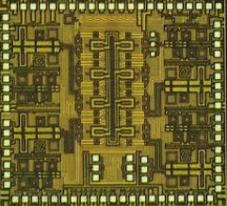
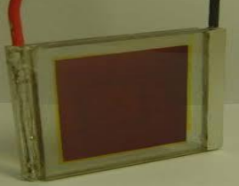
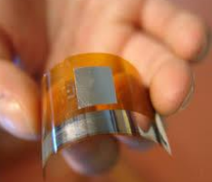
Application of PVD
PVD methods are commonly used in followings:
Circuit & IC fabrications
Aerospace & transparent coatings
Reflectors and optics

Slide 6
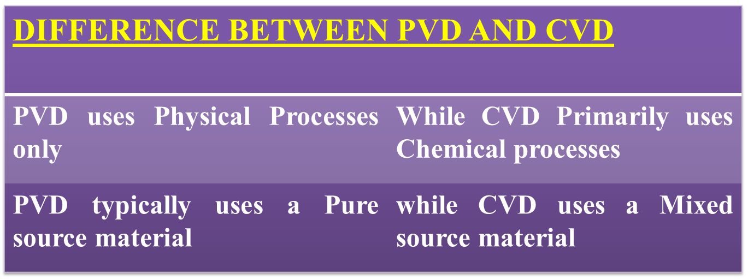
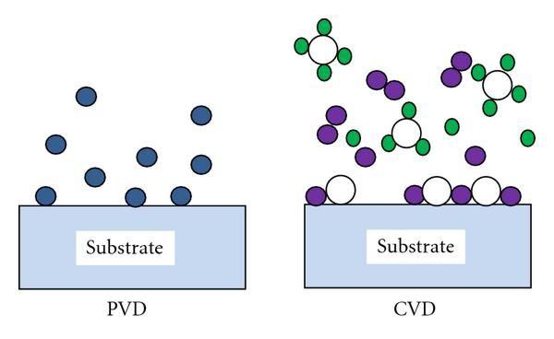

Slide 7
Applications of Nanomaterial Based Products
Automotive industry
Engineering
Medicine
Cosmetics
Textile
Sports
Chemical industry
Electronic industry

Slide 8

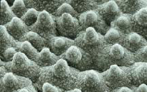
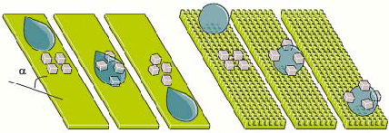
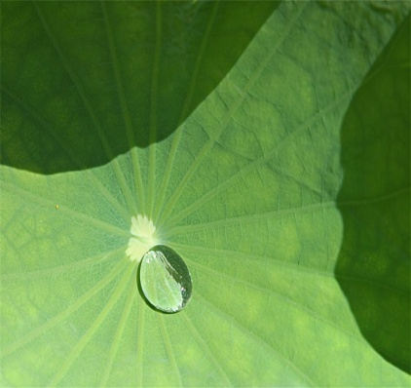
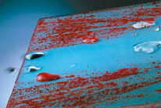
LOTUS – SELF CLEANING
Super hydrophobicity
- Self cleaning
Water lily
Surface roughness – Self cleaning
Applications -
Rinsing with water
Water drops – clean surface

Slide 9
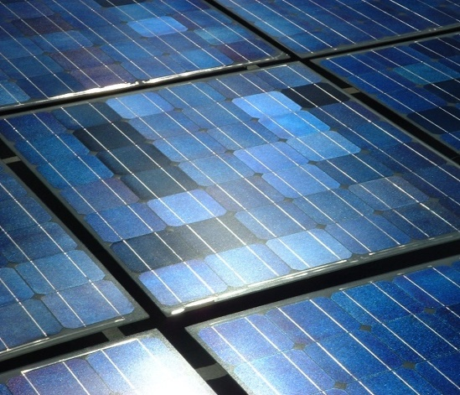
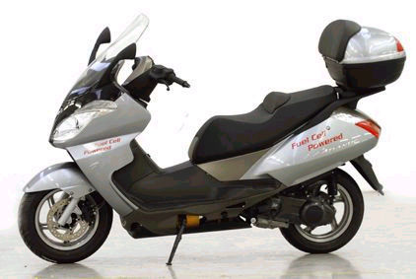
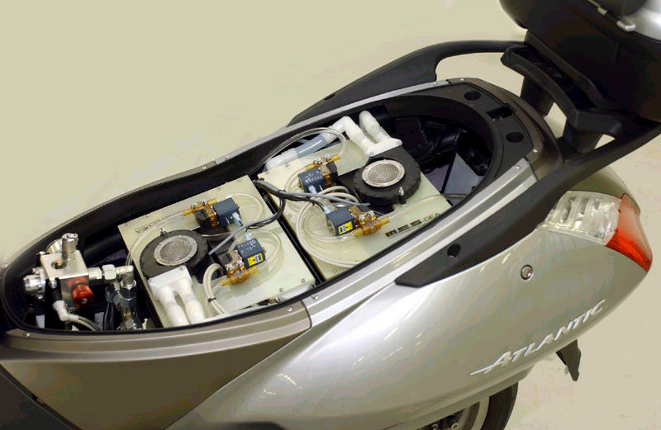
NANOTECHNOLOGY – FUEL CELL
Atlantic – Aprilia fuel cell bike
Photovoltaic cell
Hydrogen
Fuel Cell

Slide 10
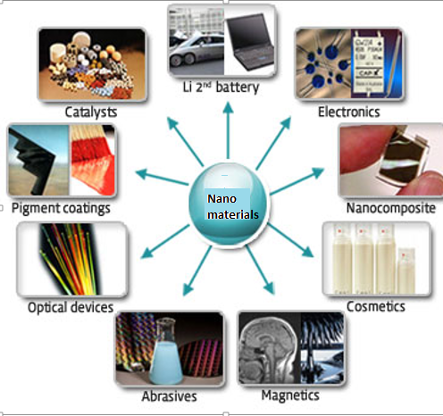

Slide 11
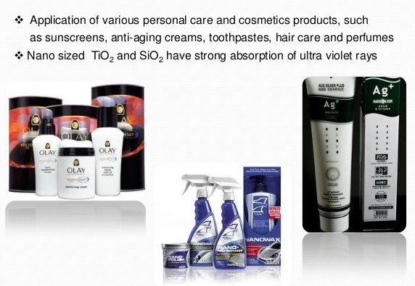
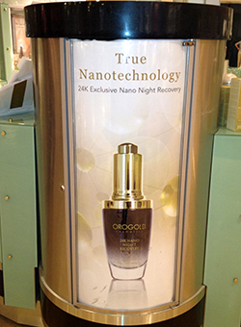
Sunscreens and Cosmetics

Slide 12
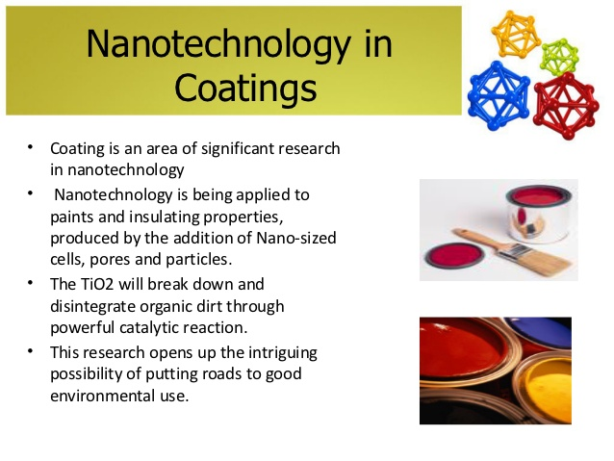
Nanotechnology in coatings

Slide 13
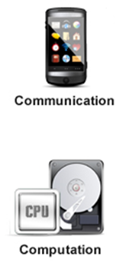
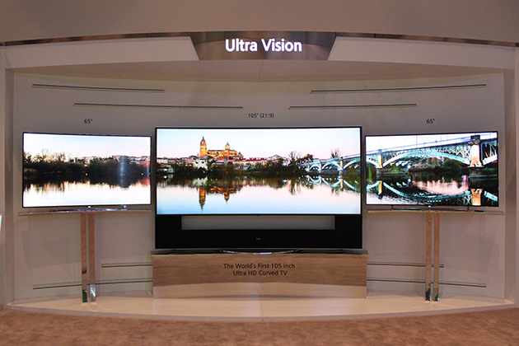
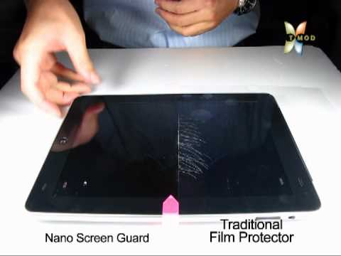
Displays
The large area, high brightness, flat-panel displays - Used in television screens and computer monitors

Slide 14
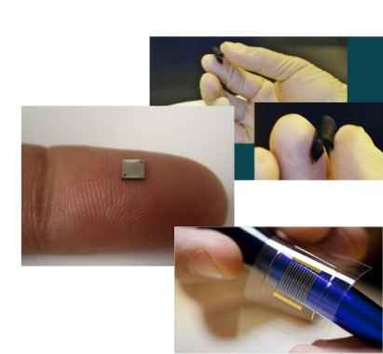
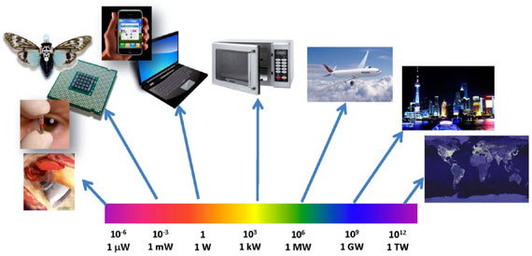
Energy
In portable electronic equipments (mobile phones, laptop computers, remote sensors) - lightweight, high energy density batteries
Fuel cells
Solar cells

Slide 15
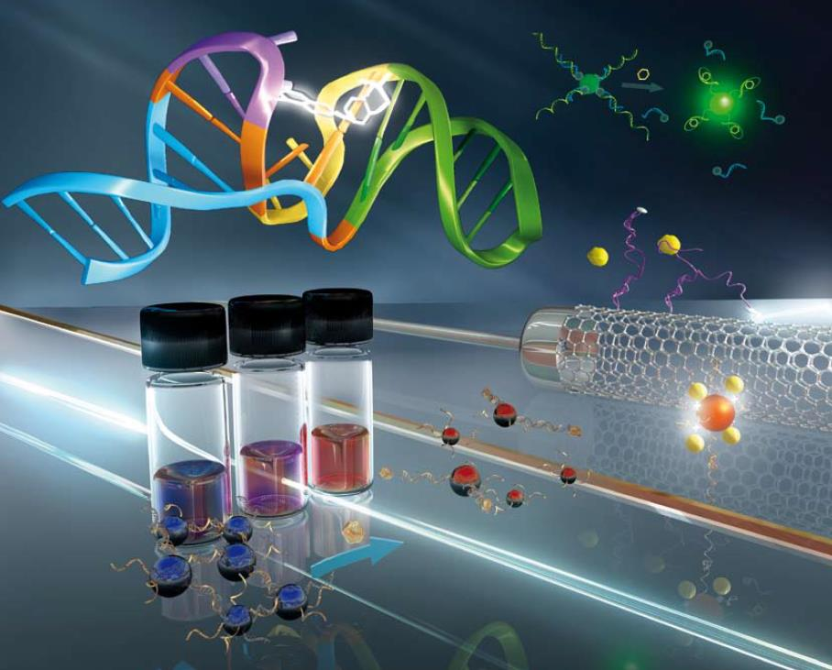
Catalysis
High surface area- High catalytic properties-Production of chemicals

Slide 16
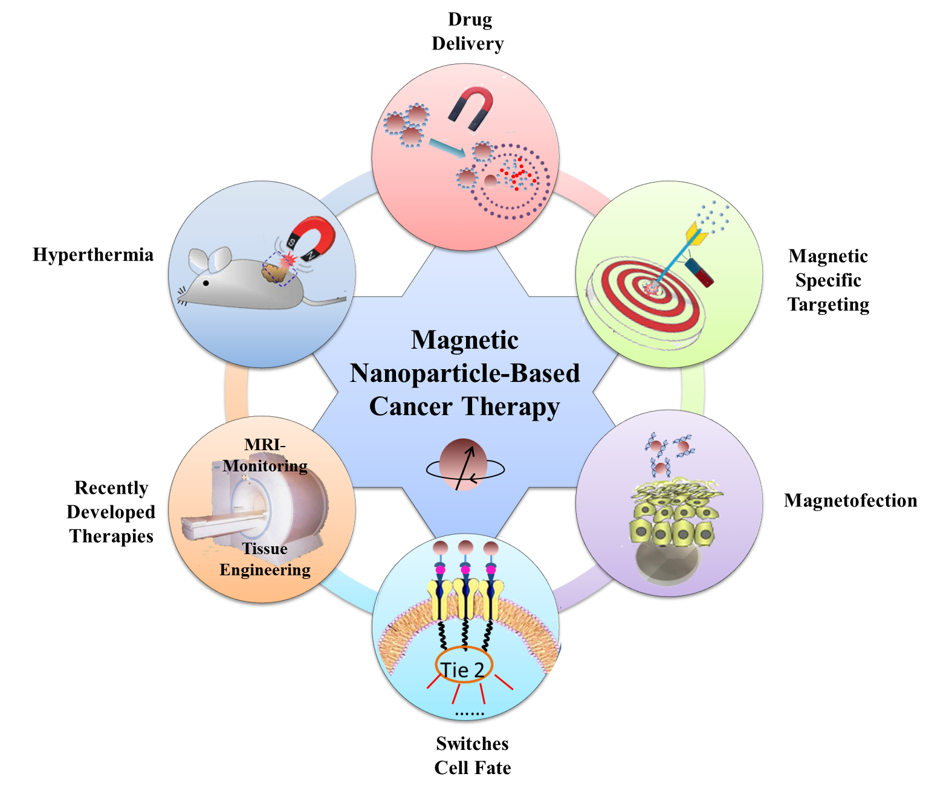
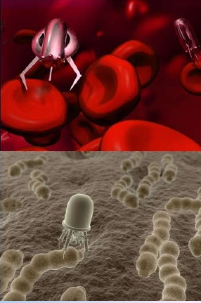
Medicine
In drugs, Medicines, therapeutics
Diagnostics of diseases
Targeted drug delivery for cancer
Surgery
Biomedical Instrumentation
Medical Robotics

Slide 17
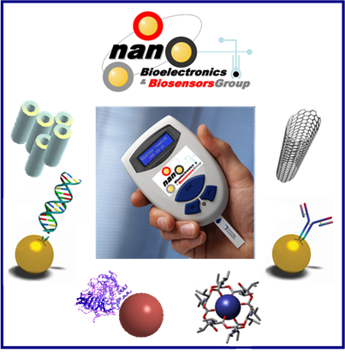
Sensors
Biosensors
Gas sensors

Slide 18
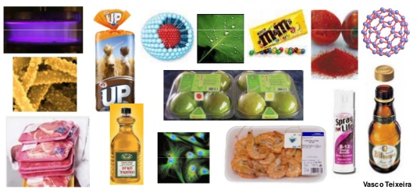
Food
In production, processing, safety and packaging of food- By placing anti-microbial agents directly on the surface of the coated film

Slide 19
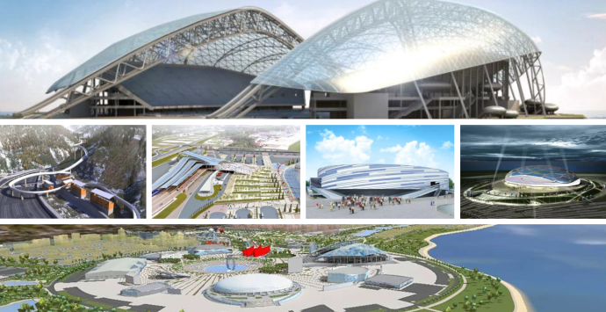
Construction
Nanotechnology has the potential to make construction faster, cheaper and safer
Automation of nanotechnology construction - Creation of structures from advanced homes to massive skyscrapers

Slide 20
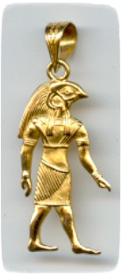


Nano material - optical properties
Applications

Slide 21
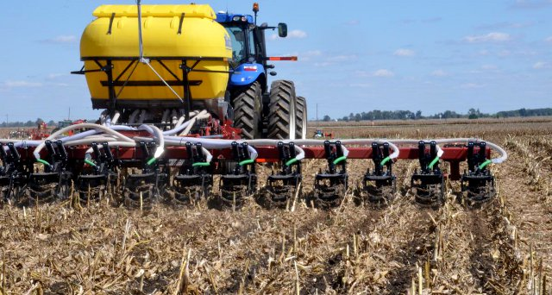
Agriculture
Applications of nanotechnology - Potential to change the entire agriculture sector and food industry from production to conservation, processing, packaging, transportation and even waste treatment

Slide 22
Summary
Physical vapour deposition method involves four steps: Evaporation, Transportation, Reaction and Deposition
PVD uses a physical process and CVD is chemical process for synthesis of nano materials
Application of nanomaterials in various industries such as in medicine, agriculture, electronic industry, automotive industry, textile industry, etc.

